Slide 1
PREDATOR 3D
Space repellent and smoke generator – protection against mosquitoes
F.RETTICH, O.ŠEBESTA, R.VYSKOČIL
National Institute of Public Health, Prague
Regional Hygienic Station, Brno
Leroy Cosmetic s.r.o, Lednice

Slide 2
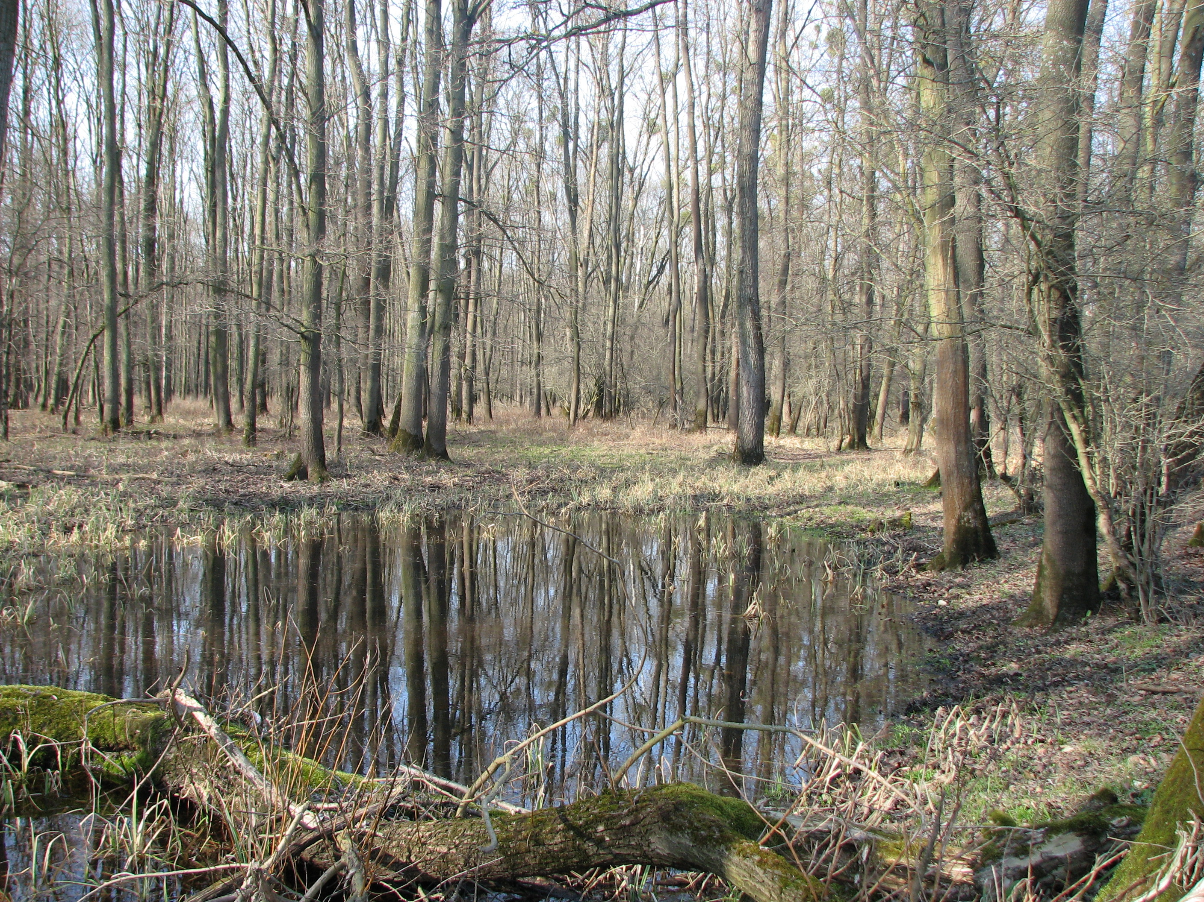
A mosquito breeding place in the flood plain forest

Slide 3
PREDATOR 3D
3D protection
Pressurized aerosol
bomb
Concentrate for
spraying
Smoke generator

Slide 4
PREDATOR 3D
A space repellent

Slide 5
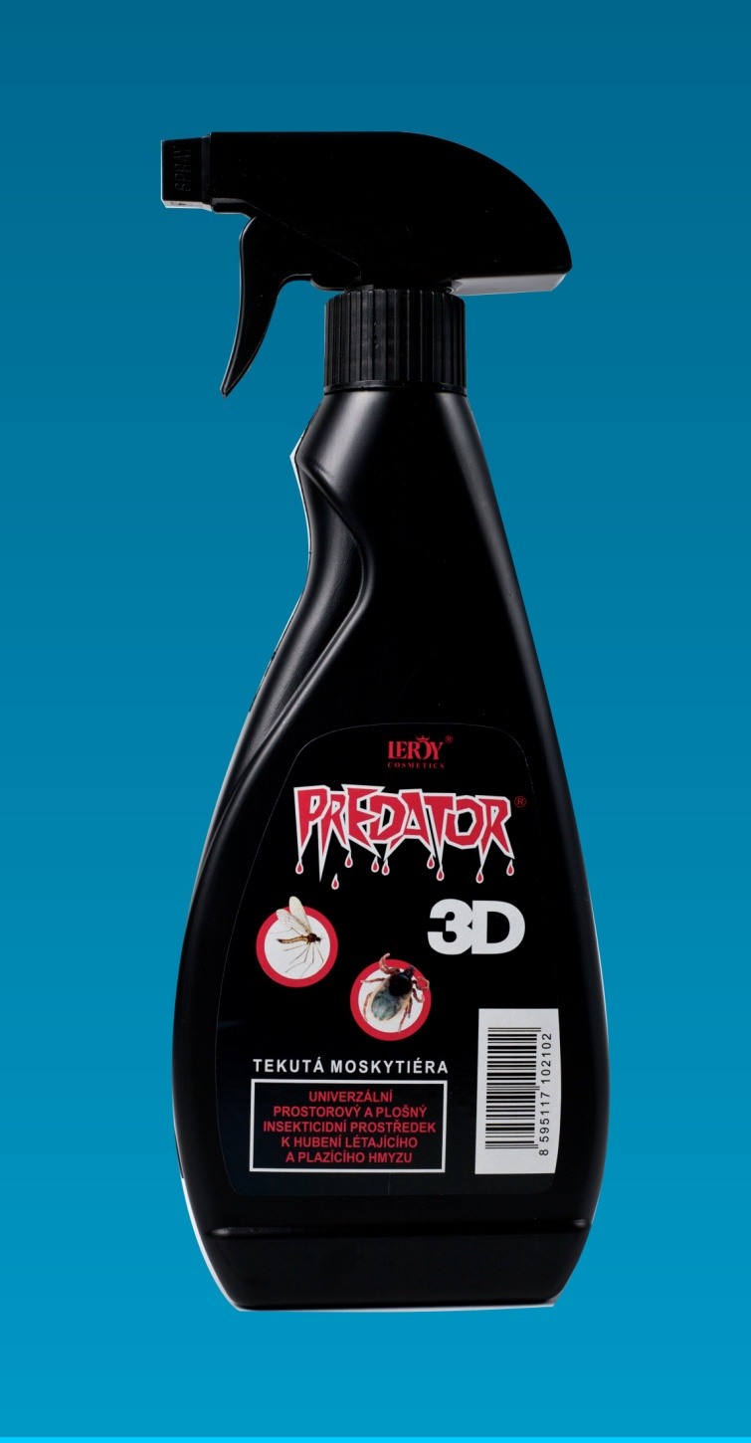

Slide 6
Number of biting Oc.sticticus mosquitoes before and after application of Predator 3D on an verandah of the log cabine (4,6 ml/m²)
Daily time (interval) | Verandah | Temp. °C | RH % | Control (forest) (per one min.)
14.00 | >50 | 30.0 | 60 | 50
14.05-14.08 | Spray application
14.08-14.23 | 5
14.24-14.44 | 8 | 30.2 | 55 | >50
14.45-.15.00 | 0
16.00-16.30 | 11 |  |  | >50
16.30-16.45 | 7
17.00 | 1-2/1 min.
18.00 | 1-2/1 min. |  |  | >50
19.00 | 3-5/1 min. | 28.5 | 72
9.30 | 1-2/1 min. | 26.6 | 65 | >50

Slide 7
PREDATOR 3D
Concentrate for spraying

Slide 8
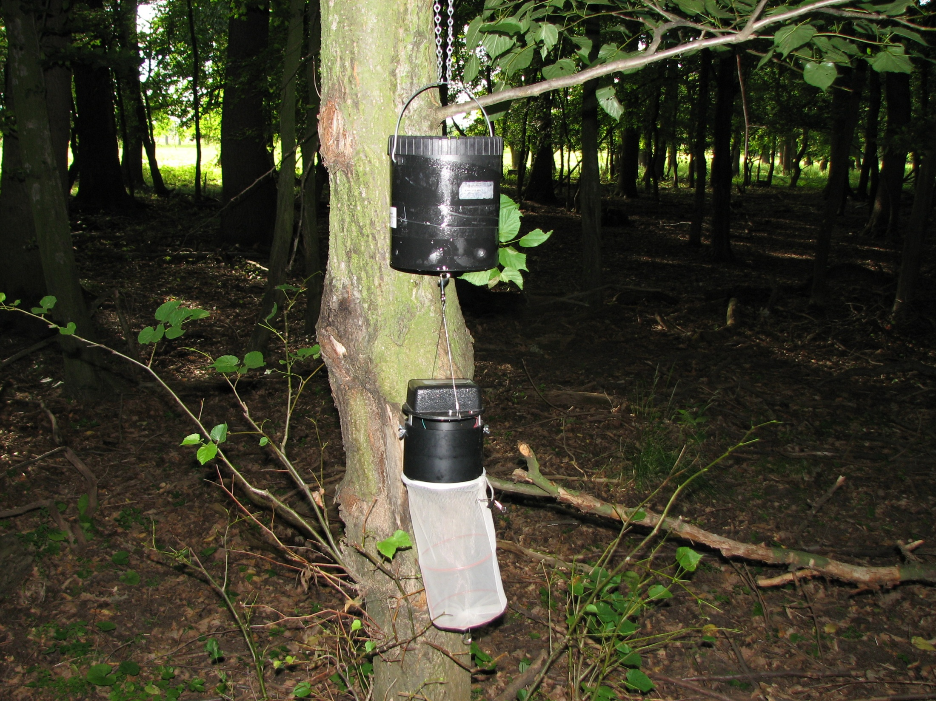
Mosquito trap

Slide 9
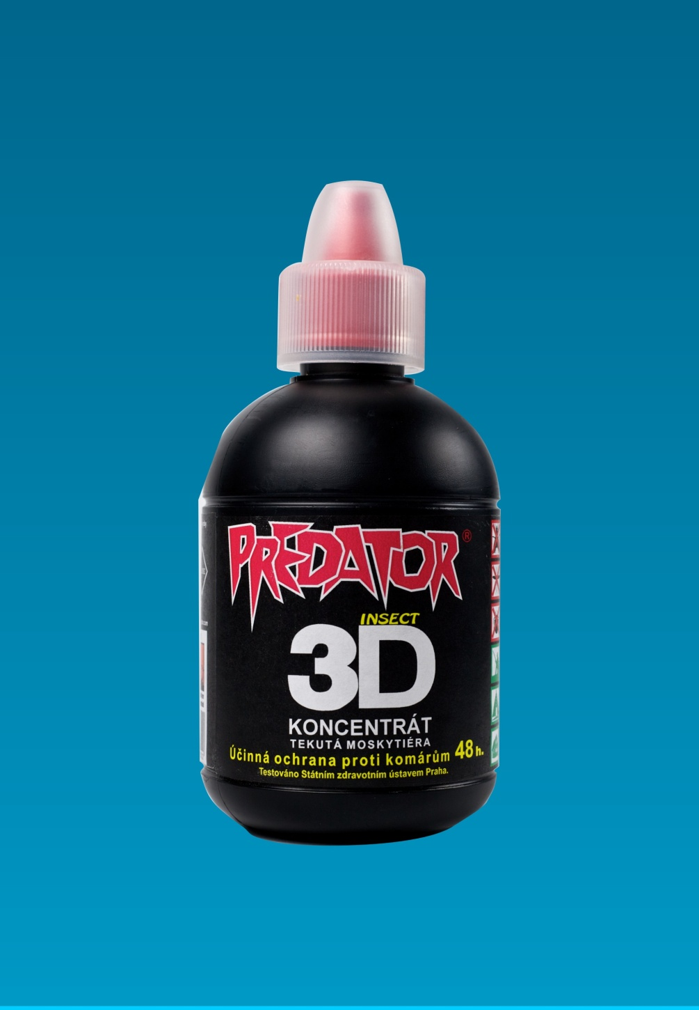

Slide 10
Effect of Predator 3D on three localities of flood plain forest
Number of mosquiotoes caught by a C0² trap. (Reduction in % in parentheses)
Locality name | ml/ha | Mg /m 2 | Before hours 0 | 2,5 hours. | 6,5 hours | 12 hours | 24 hours | 48 Hours
Mirafeldy | 90 | 0,9 | >200 | 0 | 2 | 0 | 0 | 24 (91.1%)
Doubravka | 120 | 1,2 | 364 | 0 | 0 | 0 | 21 (95.0%) | 2 (99,3%)
Schiffort | 190 | 1,9 | >200 | 0 | 0 | 0 | 5 (98,8%) | 3 (98,9)
Control | 0 | 0 | 190 | 251 | 396 | 129 | 420 | 270

Slide 11
PREDATOR 3D
Insect smoke generator

Slide 12
Advantages of use
        Easy application in heavy terain
        Fast killing (repellent) effect
        No persistance
        Ecologicaly friendly
        Handy package

Slide 13
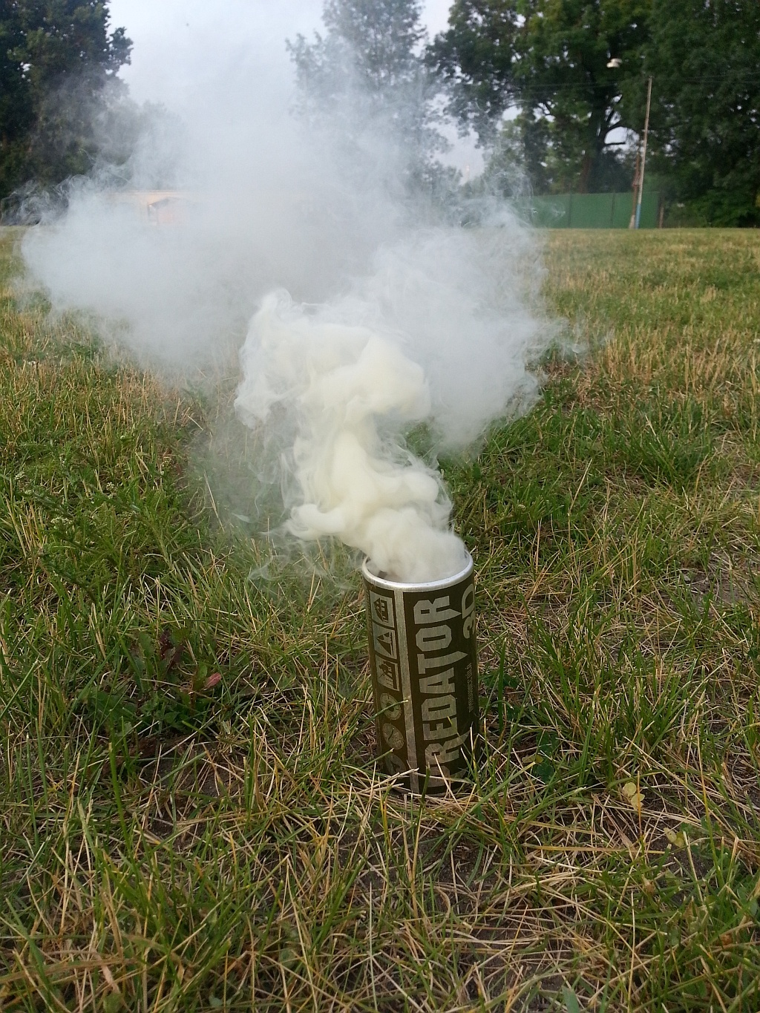

Slide 14
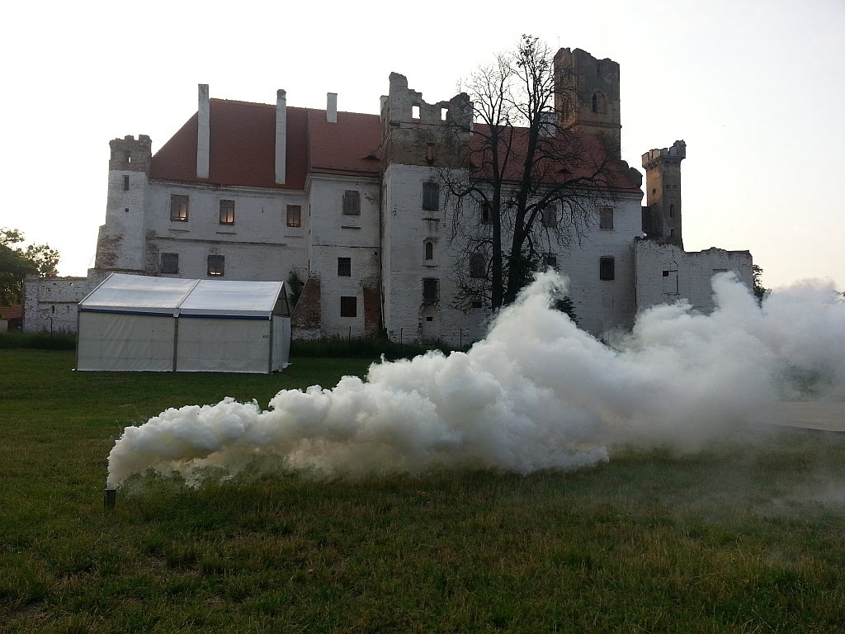

Slide 15
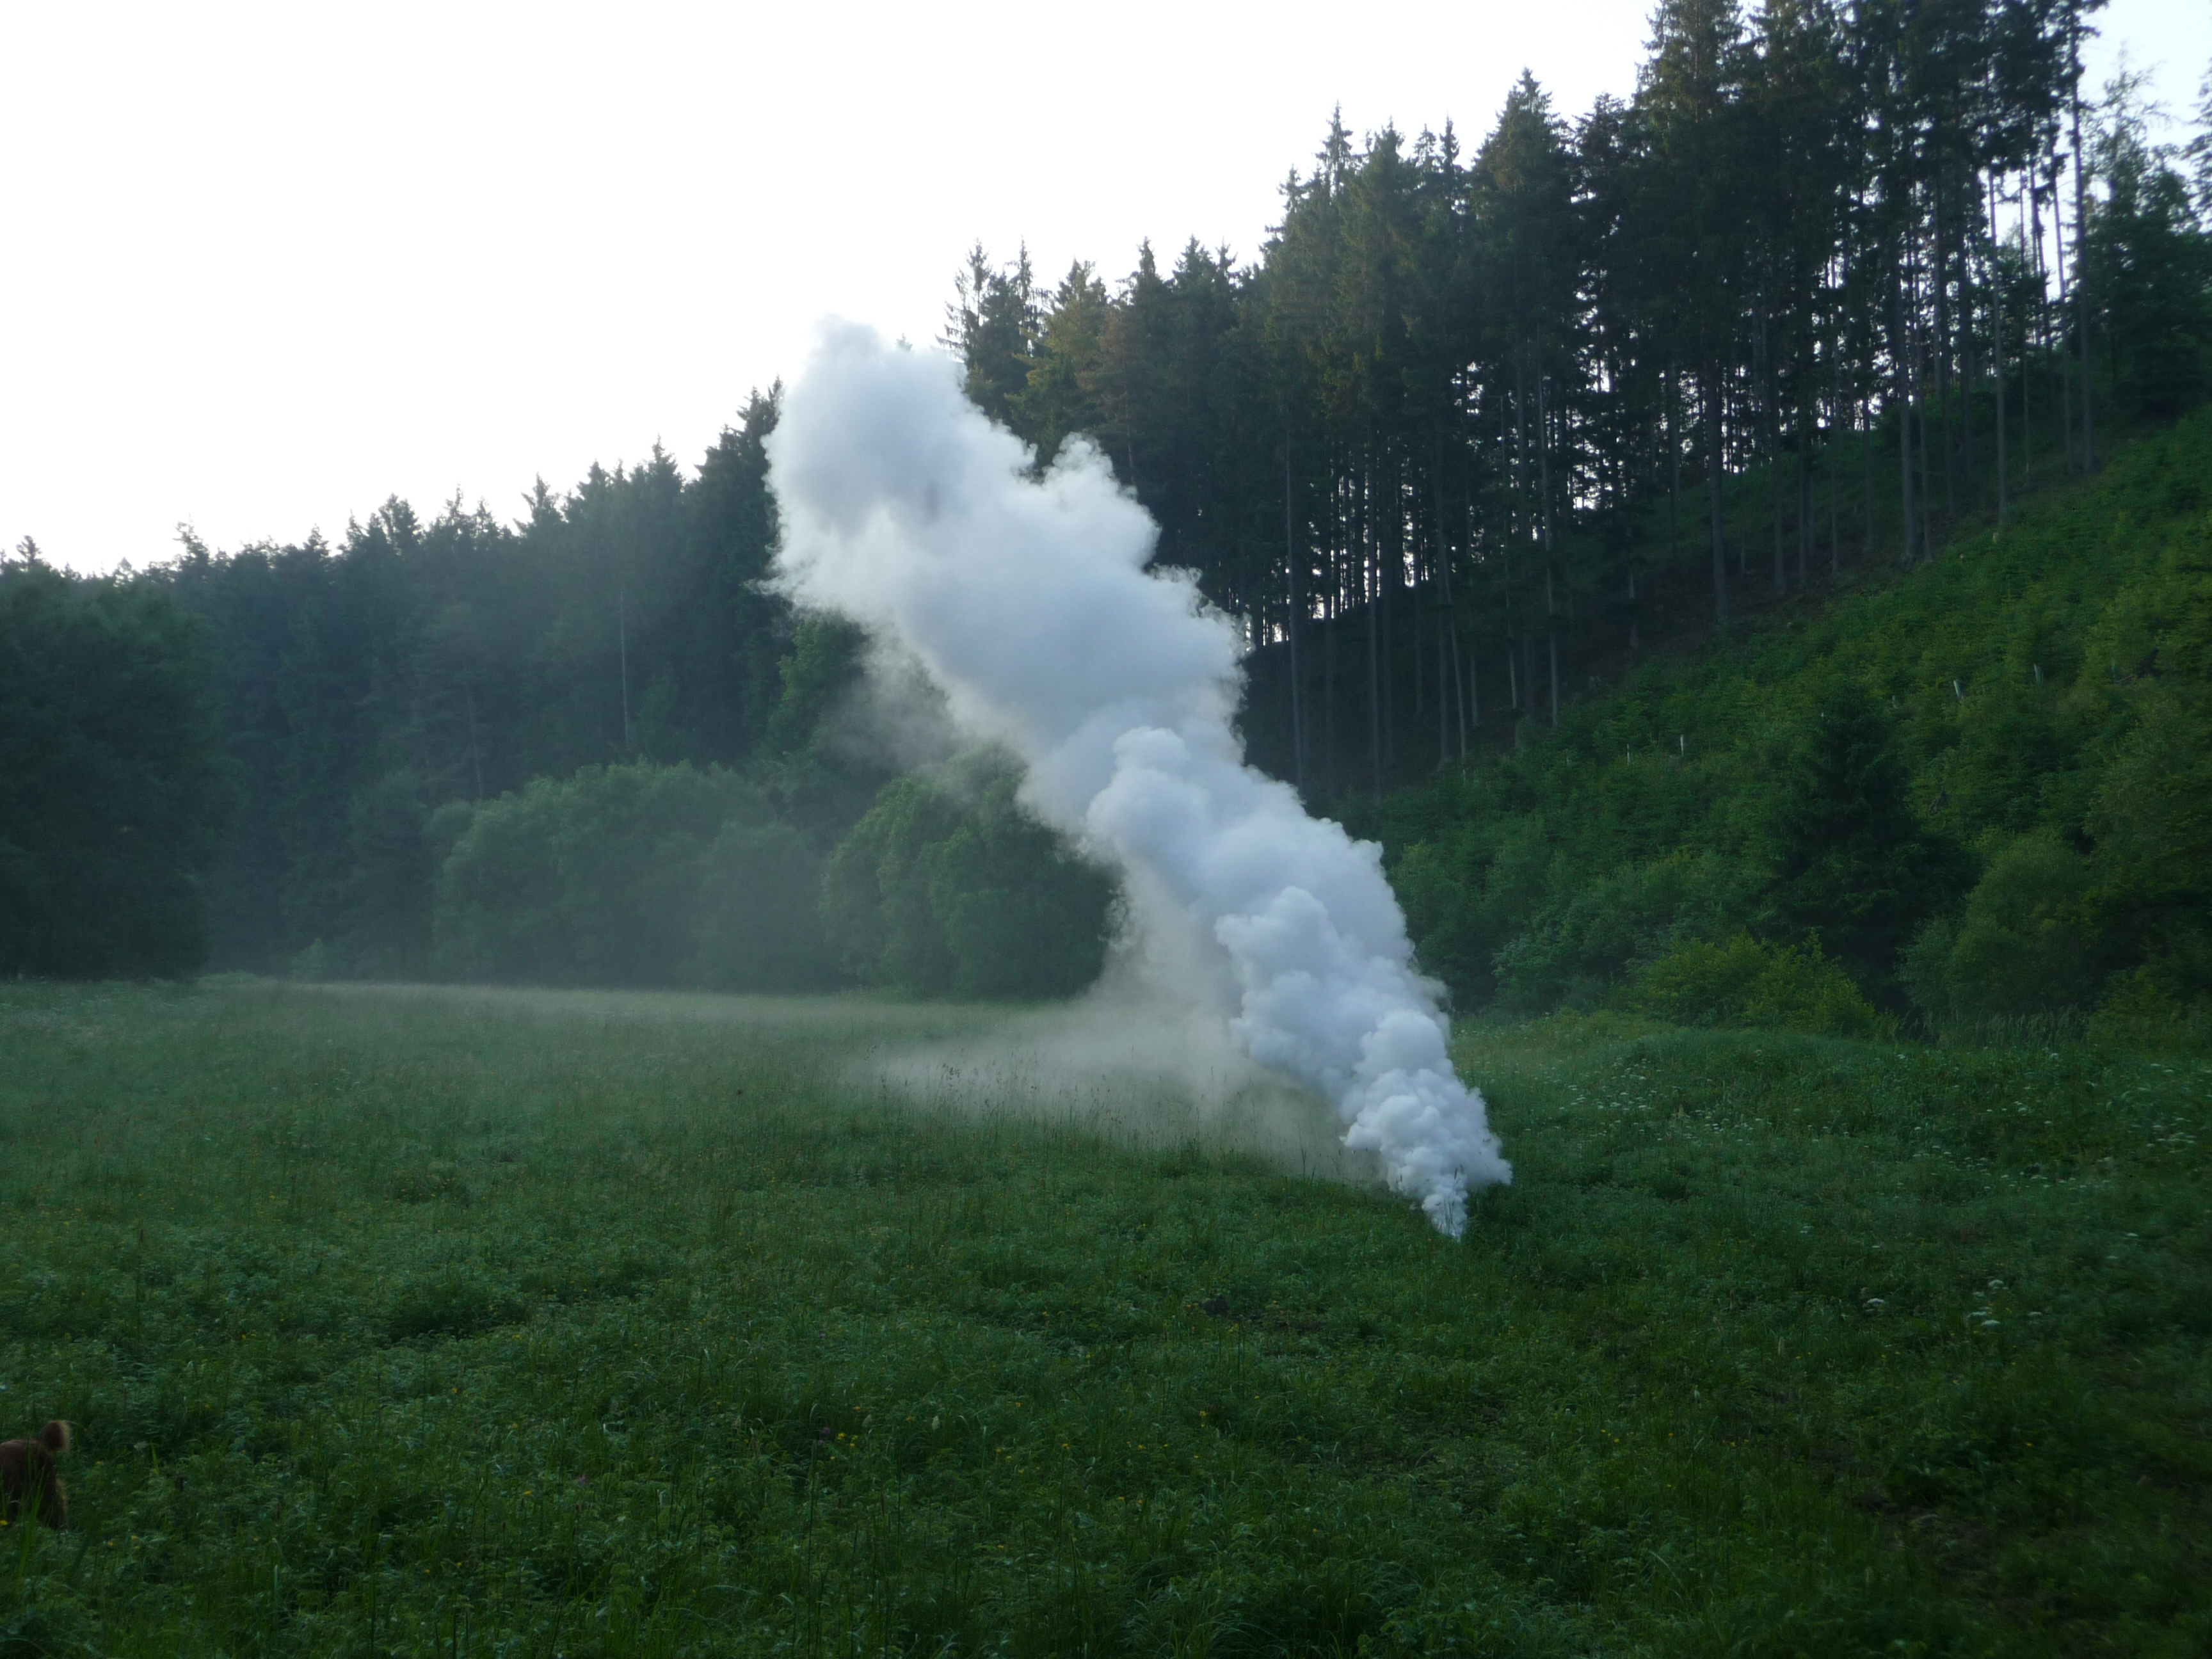

Slide 16
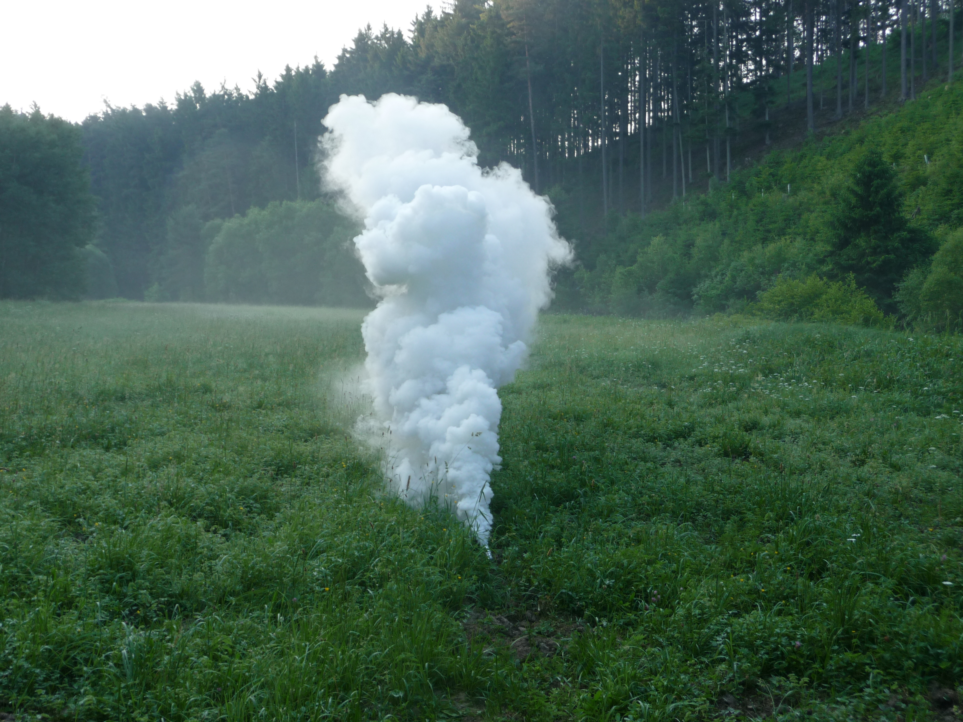

Slide 17
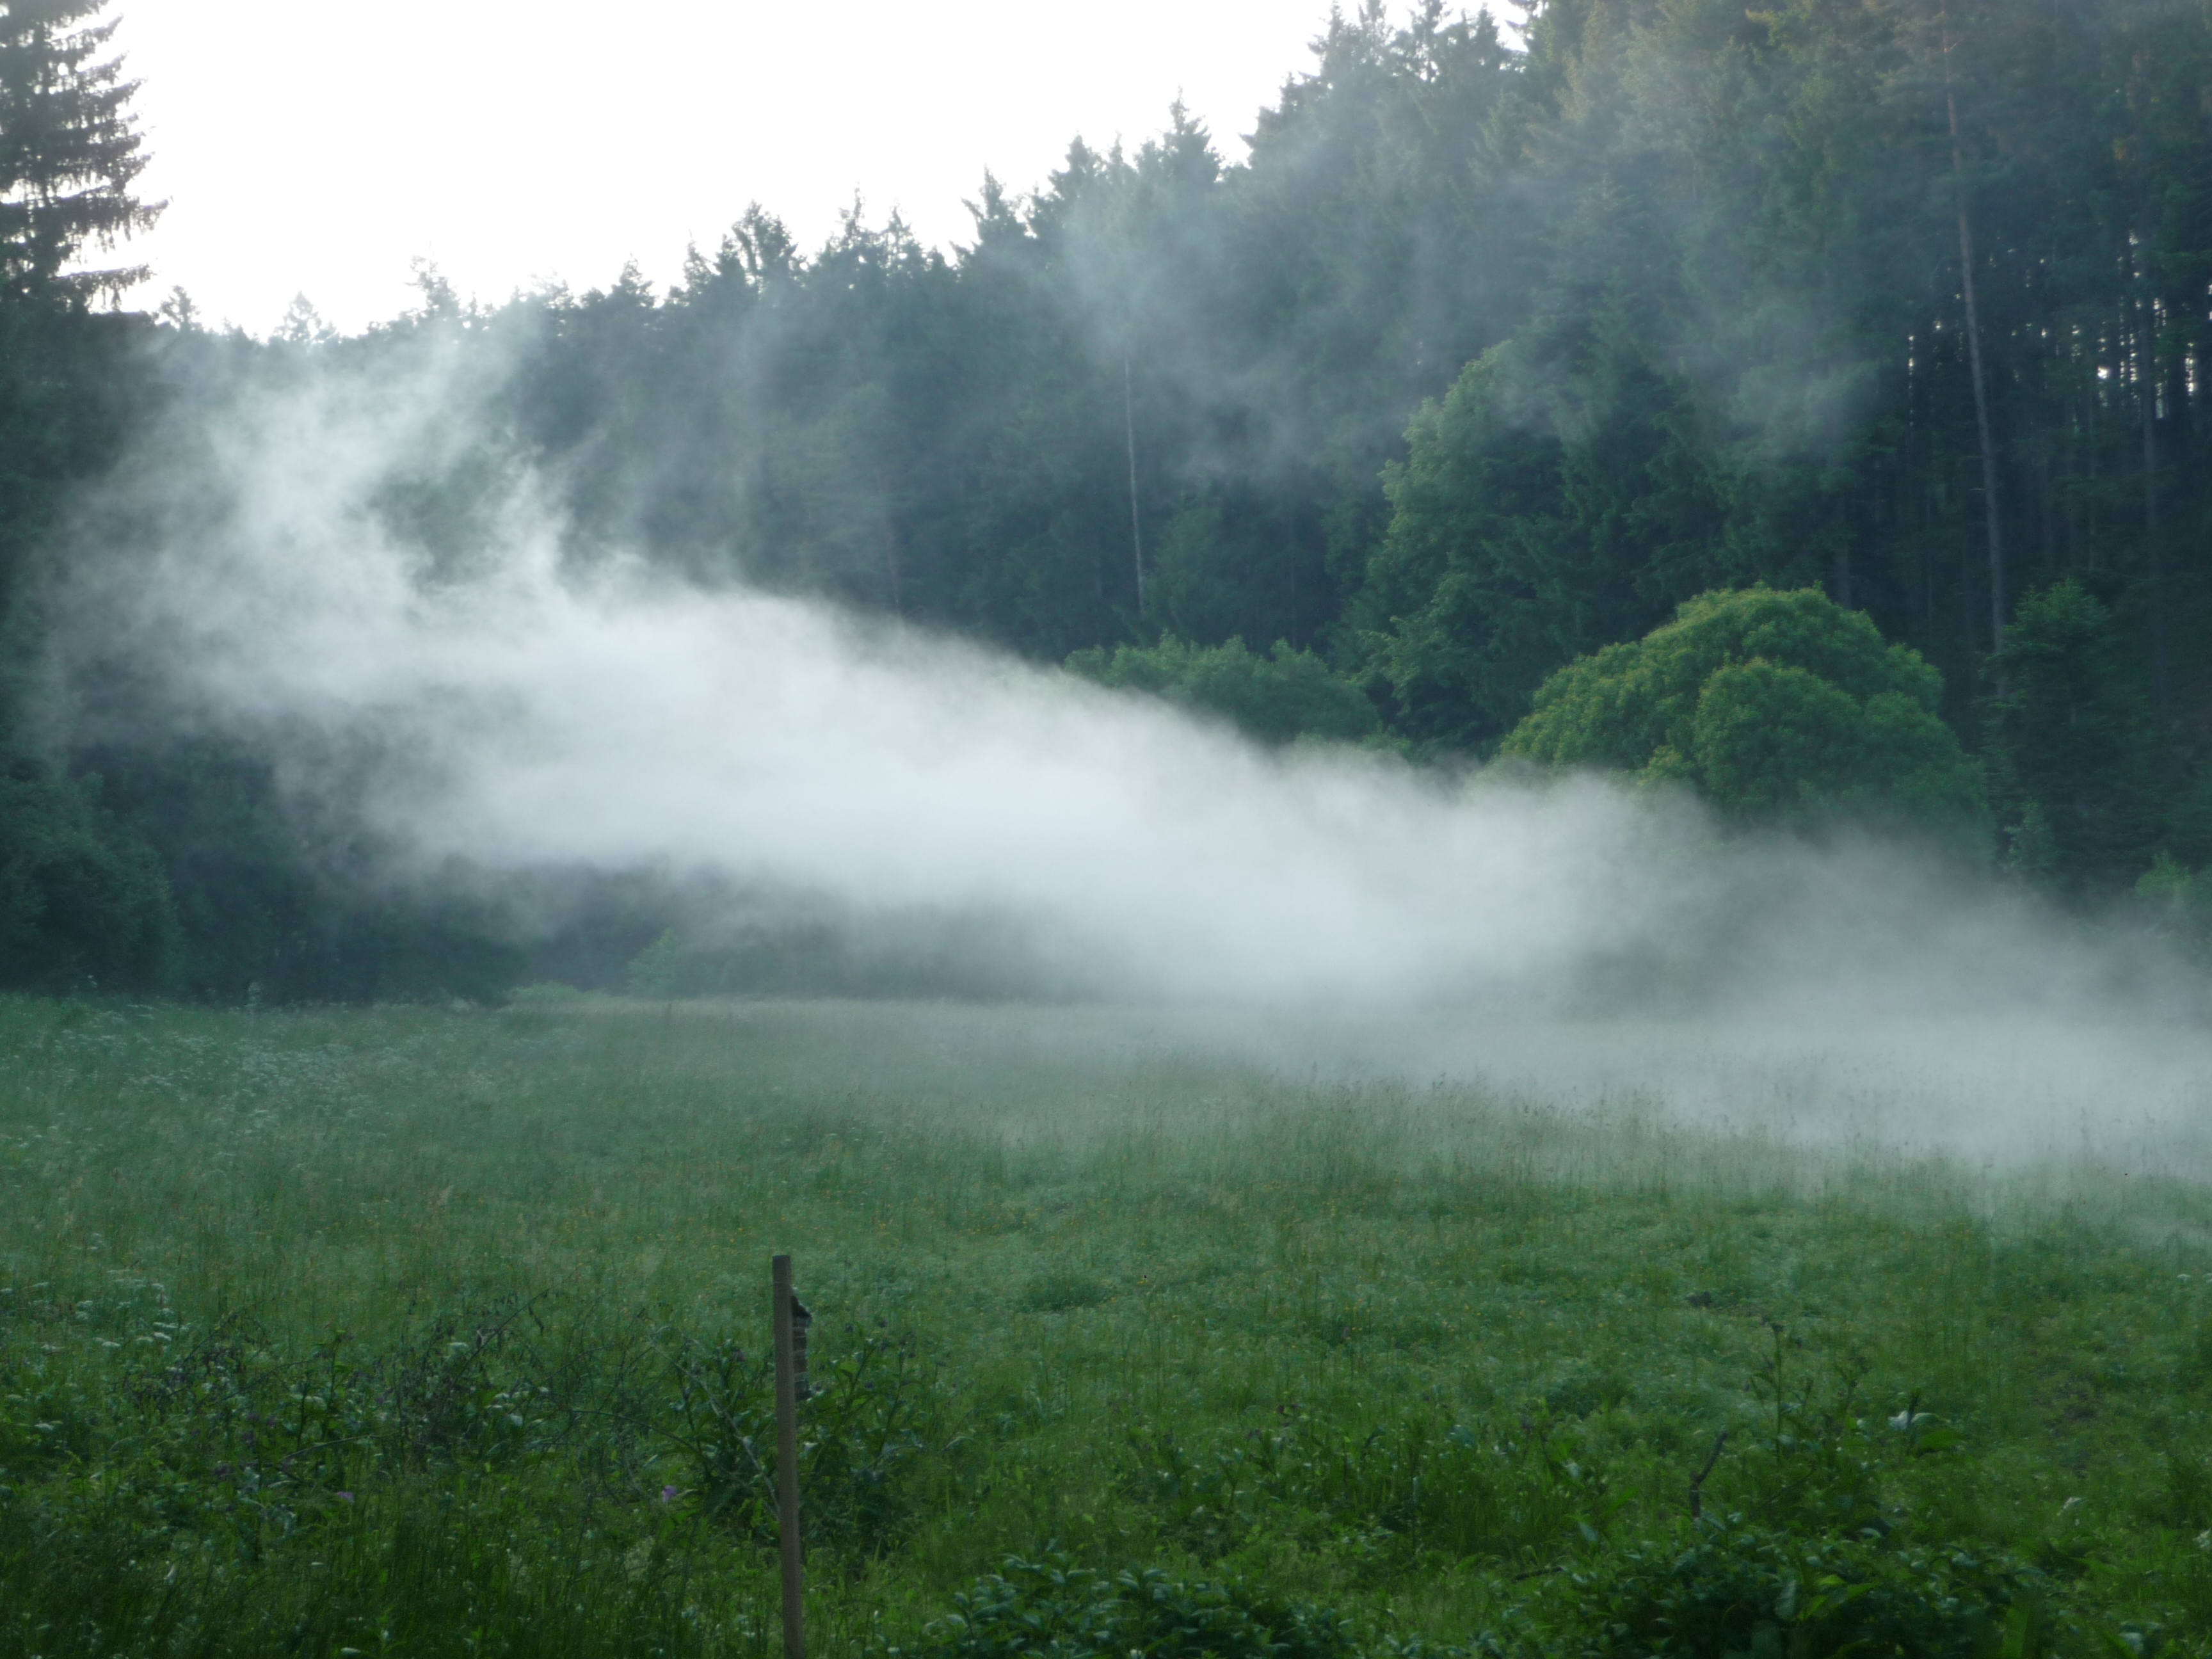

Slide 18
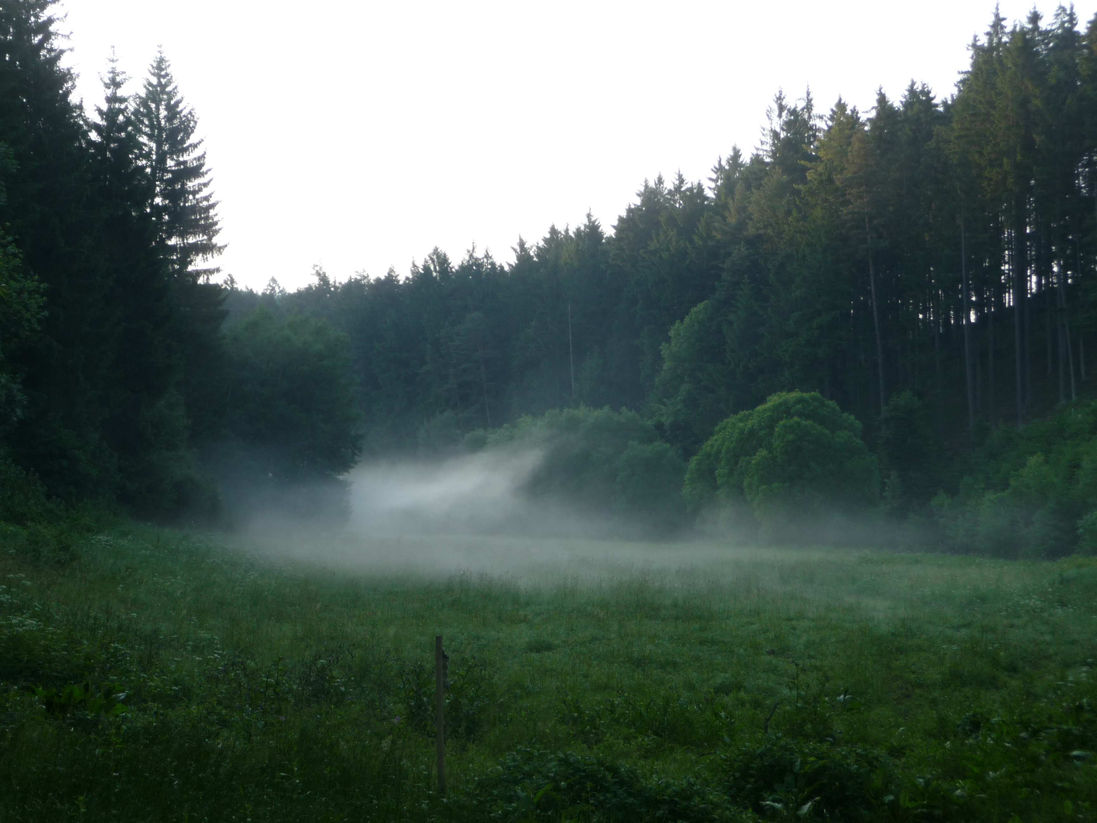

Slide 19
Effect of Predator 3D smoke generator in the flood plain forest.Average number of biting mosquitoes per one minute (reduction in % in parentheses)
Time after the treatment | Treated area | Control area
Before the application | 15-20 | 15-20
10 minutes | 0 (100 %) | 15-20
90 minutes | 0,33 (99.xx %) | 20
16 hours | 1 (95,04%) | 30
24 hours | 1,75 (91,25%) | 15-20

Slide 20
Literature
Rettich F., Ryba J. 1988. Use of insecticidal barriers against mosquito adults in flood-plain forest. SOVE Annual Conference. Cambridge UK. Abstracts.
Allan s., Kline D., Walker T. 2009. Environmental factors affecting efficacy of bifenthrin – treated vegetation for mosquitoes. J. Am. Mosq. Contr. Assoc. 25: 338-346.
Cilek J.H., Hallmon C.F. 2006. Residual effectiveness of pyrethroid-treated foliage against adult Aedes albopictus and Culex quinquefasciatus in screened field cages. J. Am. Mosq. Contr. Assoc. 22: 725-731
Cilek J.H., Hallmon C.F. 2008. Residual effectiveness of three pyrethroids on vegetation against adult Aedes albopictus and Culex quinquefasciatus in screened field cages. J. Am. Mosq. Contr. Assoc. 24: 263-269.
Doyle M.A., Kline D.L., Allan S.A., Kaufman P.E.. 2009. Efficacy of residual bifenthrin – applied to landscape vegetation against Aedes albopictus (Skuse) (Diptera, Culicidae) . J. Am. Mosq. Contr. Assoc. 25: 175-183.
Lukas J.R., Shono Y., Iwasaki T., Ishiwatari T., Spero N., Benzon G. 2007. U.S. laboratory and field trials of Metofluthrin (SumiOneR) emanators for reducing mosquito biting outdoors. J. Am. Mosq. Contr. Assoc. 23:47-54.

Slide 21
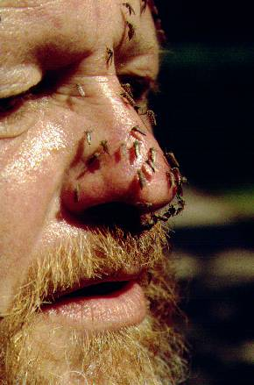

Thank you

